Slide 1
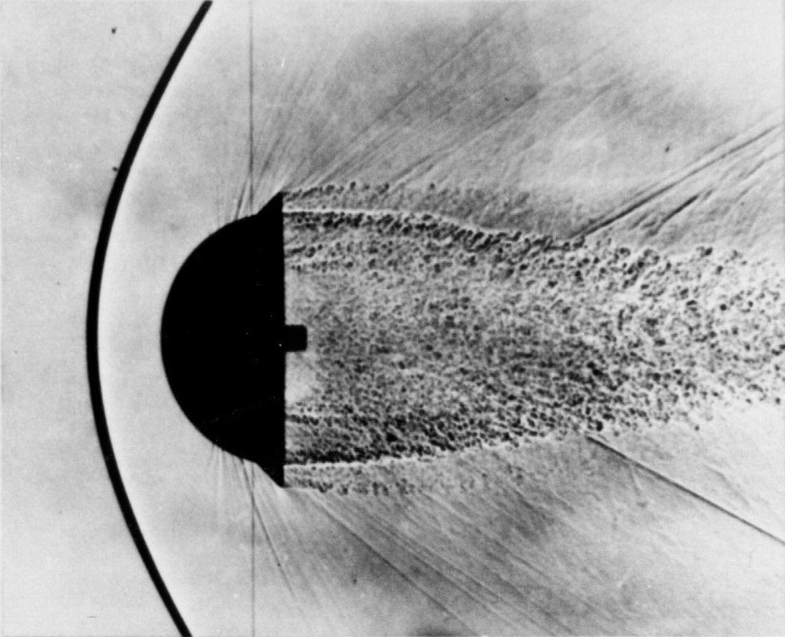

Elliptical Airfoil Detached Bow Shock Data
Notes:
Krishnan Vellore

Slide 2
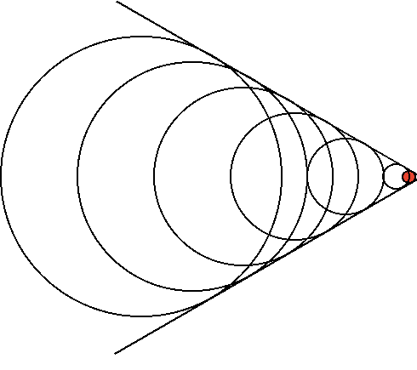
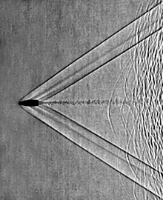
What is a shock wave?
Regions of highly compressed air in front of a supersonic body
Notes:
Krishnan Vellore

Slide 3
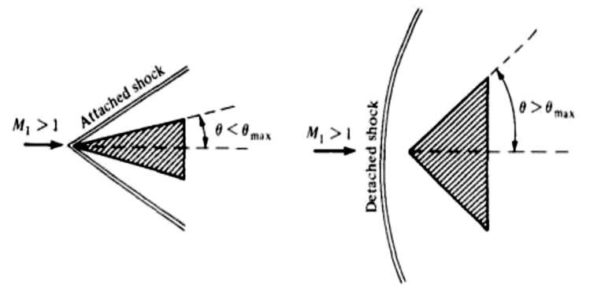
What is a detached bow shock?
Algebraic Solution
Requires CFD
CFD: Computational Fluid Dynamics
Notes:
Krishnan Vellore

Slide 4

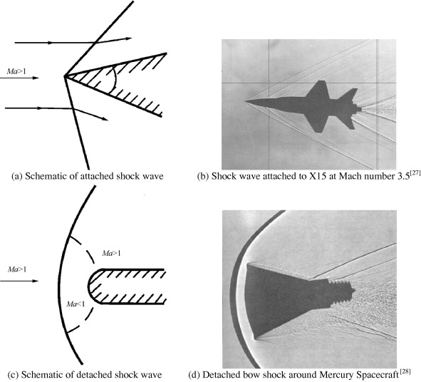
What is a detached bow shock?
Notes:
Krishnan Vellore

Slide 5
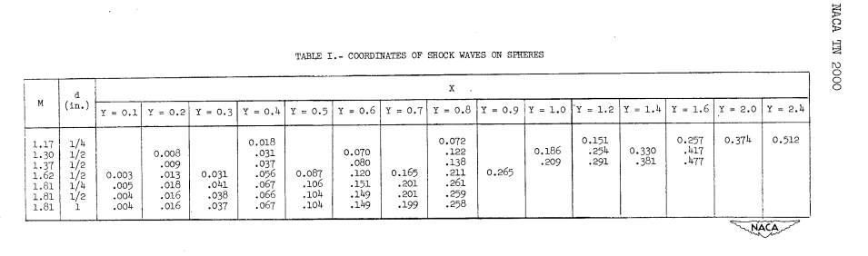
Problem?
There is very little data available for detached bow shocks for basic geometries (Spheres, Cylinders, etc)
No readily available data available for detached bow shocks for airfoils
Notes:
Garrett Stevenson

Slide 6
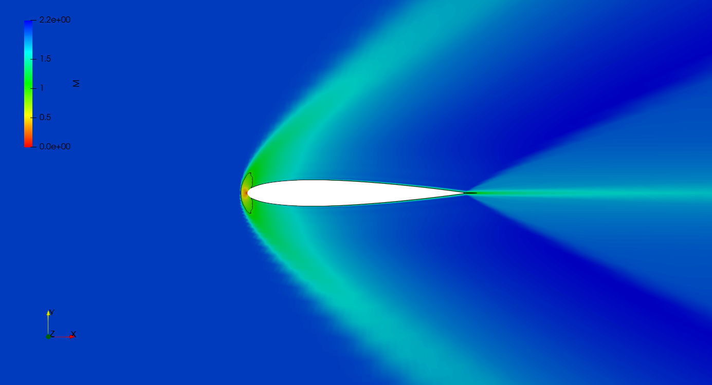
Our Solution!
Generate a large dataset of elliptical airfoils of various shapes under many different freestream Mach numbers though Computational Fluid Dynamics (CFD).
Mach Number: Speed relative to the speed of sound
Notes:
Garrett Stevenson

Slide 7
How does it work?
01
02
03
04
CFD
Shock Detection
Generate aerodynamics data from custom airfoil data
Determine the location of the shock using the pressure gradient
Data Generation
Analysis
Run the CFD 1000 times to get a wide variety of data
Verify results using High-Speed Aerodynamics Theory
Notes:
Garrett Stevenston

Slide 8
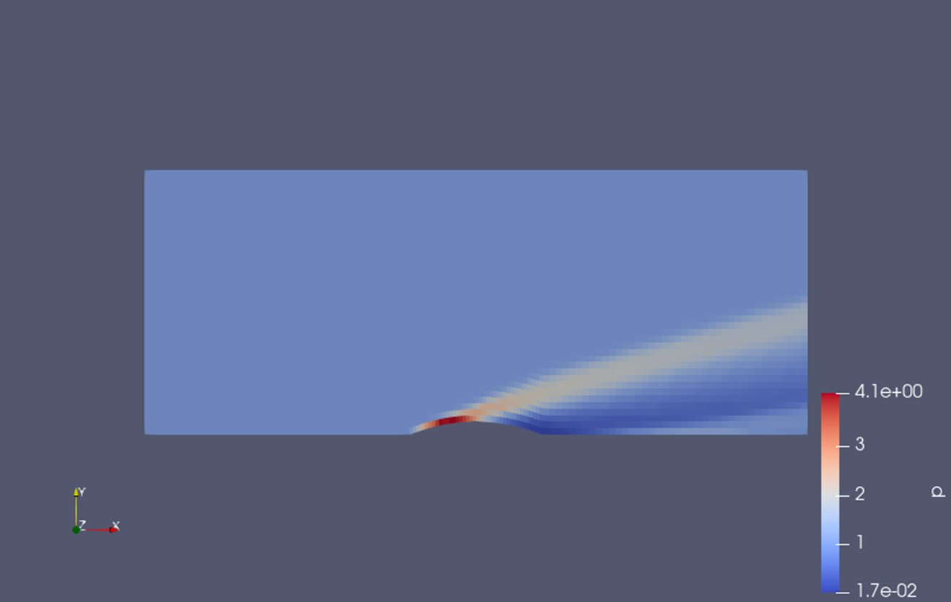
CFD
Used OpenFOAM to simulate shock formation on an custom input geometry.
Extract pressure gradient data from simulation
Shock Wave!
Notes:
Garrett Stevenson

Slide 9
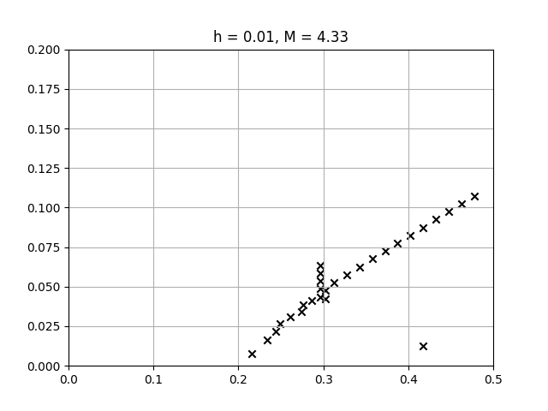
Results
1,000 Total Data Points! (CFD is expensive to run)
10 different geometries each calculates under 100 different Mach numbers
Script allows you to instantly plot any dataset
Notes:
Garrett Stevenson

Slide 10

Plot Report
CSV results of dataset converted
to plot images
Auto-generated latex report of plot

Slide 11
Application
Pre-computed detached bow shock wave CFD data is now available to anyone who needs it, something that previously did not exists.
Quicker computation times. Looking up a value from a table is quicker than CFD.
Easily adaptable beyond only elliptical airfoils
Aerodynamic Modeling
Industry standard to use aerodynamic lookup tables rather than realtime aerodynamic computations
Notes:
Garrett Stevenson

Slide 12
Wrapping things up
The team created a novel dataset to fix the issue of the absence of data for detached shock waves for airfoils. The team utilized Computational Fluid Dynamics to generate 1000 data sets for these shock waves.
Notes:
Garrett Stevenson

Slide 13
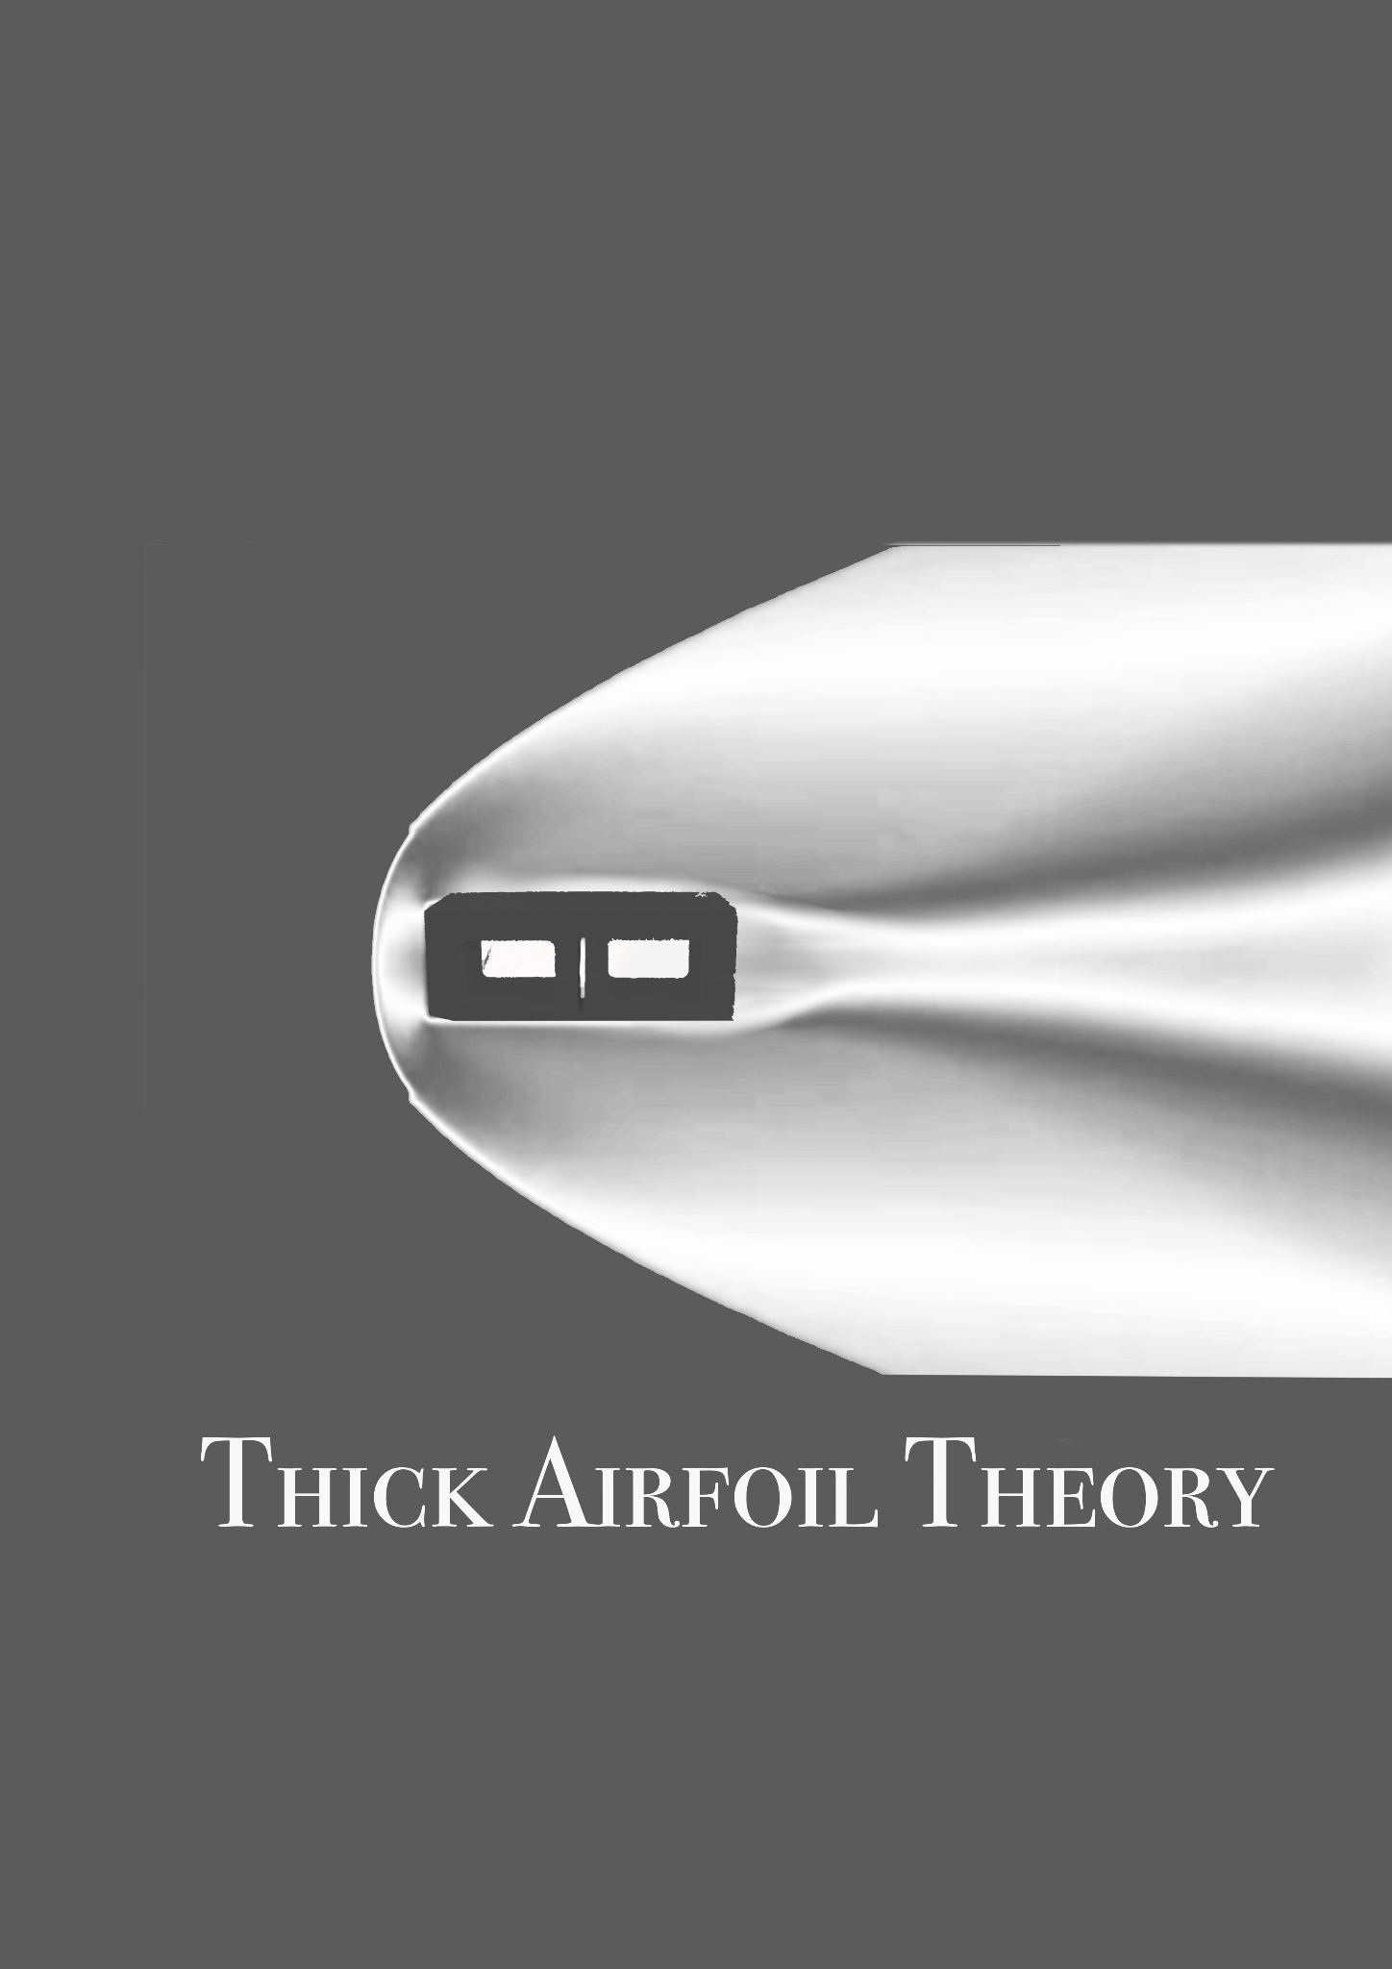
Come visit us at our table!
Notes:
Krishnan Vellore

